Slide 1
CLOUD ENABLED VEHICHLE THEFT AND ACCIDIENT DETECTION SYSTEM

Slide 2
TEAM MEMBERS
V Ajay Kumar R Seetha Ram G Yaswanth

Slide 3
PROBLEM STATEMENT
Cloud enabled vehicle theft and
accident detection system

Slide 4

ABSTRACT
With the advancement in technology and increasing traffic, road accidents and traffic hazard have increased, causing more chances of loss of life due to lack of timely help facilities. This project is an attempt towards solutions for timely accident notification, vehicle theft control. The projects records the parameters of vehicle at regular intervals of time, through a “smart device” installed in the vehicle and sends these values onto the cloud, vehicle owner or a third party. Based on the information, appropriate algorithms are implemented to send alerts and initiate action. The system will facilitate the users in a number of ways such as notification for immediate aid in case of accident, tracking the vehicle in cases of theft and disabling the vehicle remotely

Slide 5
PROPOSED WORK
For vehicle theft, in this project for opening of the door we first click on the button, after few seconds we get an OTP (random number) generated by Arduino through GSM module to the phone number stored in the Arduino, we again text back the same random number. After, some time the OTP will be checked, if it’s correct the door will be opened, in our project the servo motor rotates, if it’s wrong the buzzer will ring indicating someone is opening or stealing the vehicle
For accident detection, The project records the parameters of vehicle (car in our case) at regular intervals of time, through a “smart device” installed in the vehicle and sends these values onto the cloud(for further processing), vehicle owner (when required) or a third party. The device is made up of various sensors, modules and microprocessor and is safely suitable for the vehicles as it does not interfere with the hardware or normal functioning of the vehicle. A mobile phone is also used for owner's interaction with the device installed in the vehicle, so that, when the owner wants to track the vehicle, only he/she can do it.

Slide 6
PROPOSED WORK
In this work, we use the accelerometer to detect the position in different axis (to detect the toppling condition) of the car during accident. The output of the accelerometer acts as an input to the microcontroller present on the board. GPS module fitted onto device computes the latitude and longitude value for the vehicle.
The GSM module present on the device will be used to send message to the secondary number provided by the owner at the time of purchase of the device, the phone number is being saved into device memory. The time, latitude and longitude values are recorded periodically. The sensor value is transmitted to the cloud in the event of occurrence of accident. A continuous application runs in the background that compares the sensor field for each vehicle recursively with some standard value. A deviation from the standard value retrieves address of location of last updated longitude and latitude using API. The occurrence of accident is being timely informed to nearby hospital and Police using Twilio message service. With the GSM and GPS module being installed in device, real time location of the car can be tracked out that will help police for the recovery of stolen car.

Slide 7

WORKING OF THE SYSTEM
The sensors are used to detect the stimuli and microprocessor (arduino uno board ) evaluates the response from sensors to perform action such as initiating message / data transfer.
GPS technology is employed to gather the information of the speed and the location (latitude and longitude) of the vehicle.
The GSM module is used to send messages to the vehicle owner/third party when required . The external interface to the Internet, SMS service is also provided by the device.
API is used for data logging on the cloud server. The processing of data is carried onto the cloud.

Slide 8
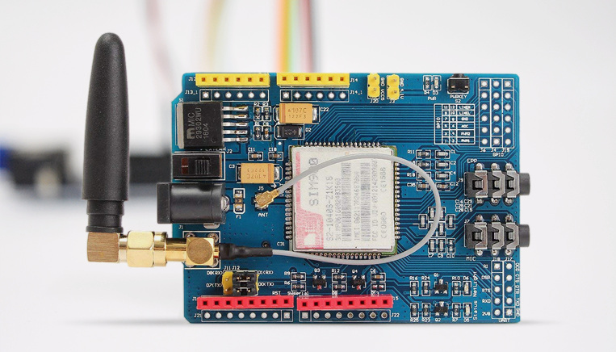
Global Positioning System (GPS)
The Global Positioning System (GPS) as shown in Figure 1 is a space-based satellite navigation system that provides location and time information in all weather conditions, anywhere on or near the Earth where there is an unobstructed line of sight to four or more GPS satellites

Slide 9
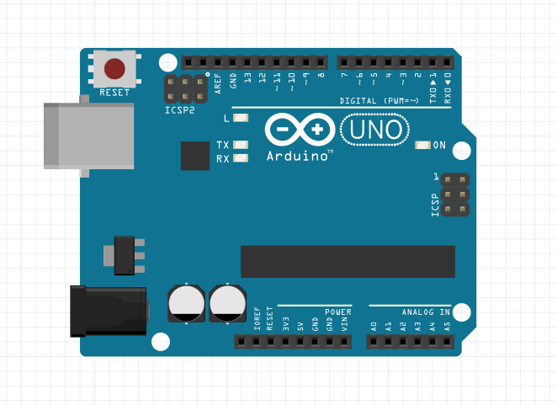
Arduino UNO
The Arduino UNO is an open-source microcontroller board based on the Microchip ATmega328P microcontroller and developed by Arduino.cc. The board is equipped with sets of digital and analog input/output (I/O) pins that may be interfaced to various expansion boards (shields) and other circuits.[1] The board has 14 Digital pins, 6 Analog pins, and programmable with the Arduino IDE (Integrated Development Environment) via a type B USB cable. It can be powered by a USB cable or by an external 9 volt battery, though it accepts voltages between 7 and 20 volts. It is also similar to the Arduino Nano and Leonardo

Slide 10
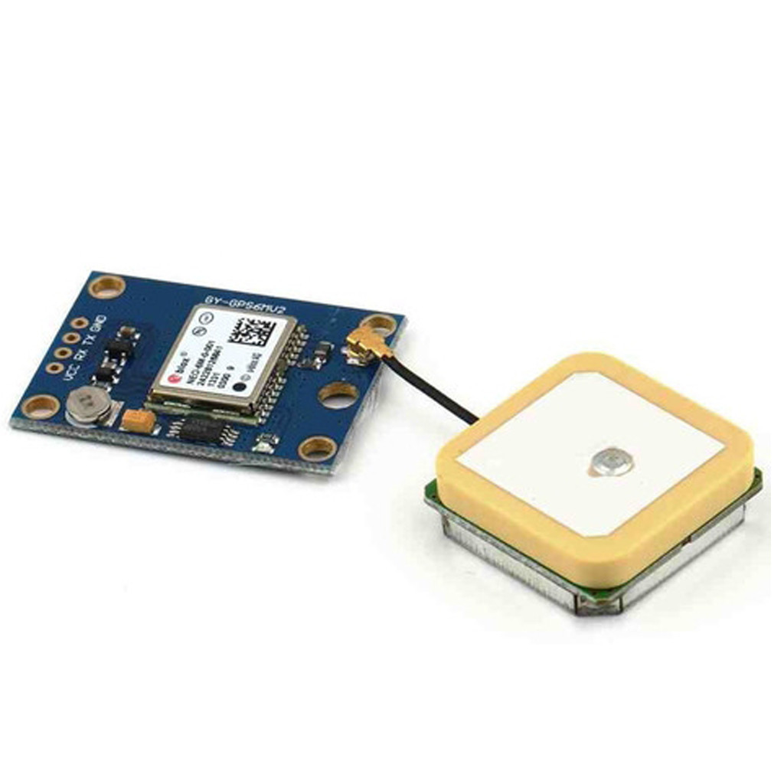
GSM module
Global System for Mobile Communication (GSM) is a digital mobile telephony system that is widely used in Europe and other parts of the world. GSM uses a variation of time division multiple access (TDMA)

Slide 11
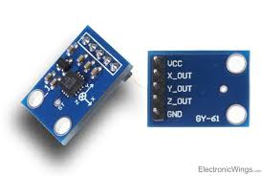
Accelerometer
An accelerometer is a device that measures proper acceleration ("g-force"). Accelerometers are used to detect and monitor vibration in rotating machinery. Pairs of accelerometers extended over a region of space can be used to detect differences (gradients) in the proper accelerations of frames of references associated with those points. These devices are called gravity gradiometers, as they measure gradients in the gravitational field. Such pairs of accelerometers in theory may also be able to detect gravitational waves

Slide 12




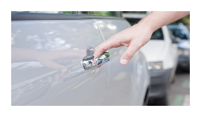

THEFT CONTROL

Slide 13
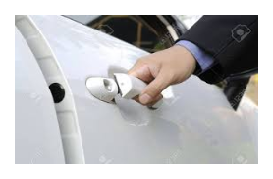
AUTHORIZED ACCESS

Slide 14

UNAUTHORIZED ACCESS
No response

Slide 15
ACCIDENT DETECTION

Slide 16
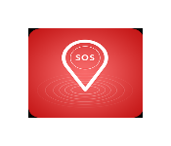



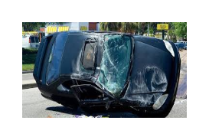

Slide 17
Conclusion
The project uses cloud computing along accident detection and information alert, real time vehicle tracking. The interface between the vehicle and cloud is the internet and that between user and cloud is SMS service.

Slide 18

LIMITATIONS
The system provides a service for only alarming the authorities rather giving a solution to cope with accident. The system requires constant internet connectivity throughout its working. The above discussed approach is totally dependent on mobile device, if for any reason, the mobile network is disrupted , the safety of the occupant cannot be guaranteed.

